Slide 1
WEBINAR: Make Your Project a Perfect Fit for Retrofit

Slide 2
Agenda
1:00 pm – Welcome
1:05 pm – Who is Enova Power – Refresher
Jeff Quint, Manager, Innovation & Communications, Enova
1:10 pm – Overview of Save on Energy Programs
Nicole L. Hynum, Supervisor, Business Development, IESO
1:40 pm – Enova’s Key Account Team and Support
Andrew Bennett, Key Account Advisor, Enova
Chris Drygala, Key Account Advisor, Enova
1:50 pm – Wrap-up and questions
2

Slide 3
Who is Enova Power? - Refresher

Slide 4
Enova Power Fast Facts
Notes:
We want to be the trusted energy provider, dedicated to delivering safe and reliable energy solutions that power our communities forward.

Slide 5
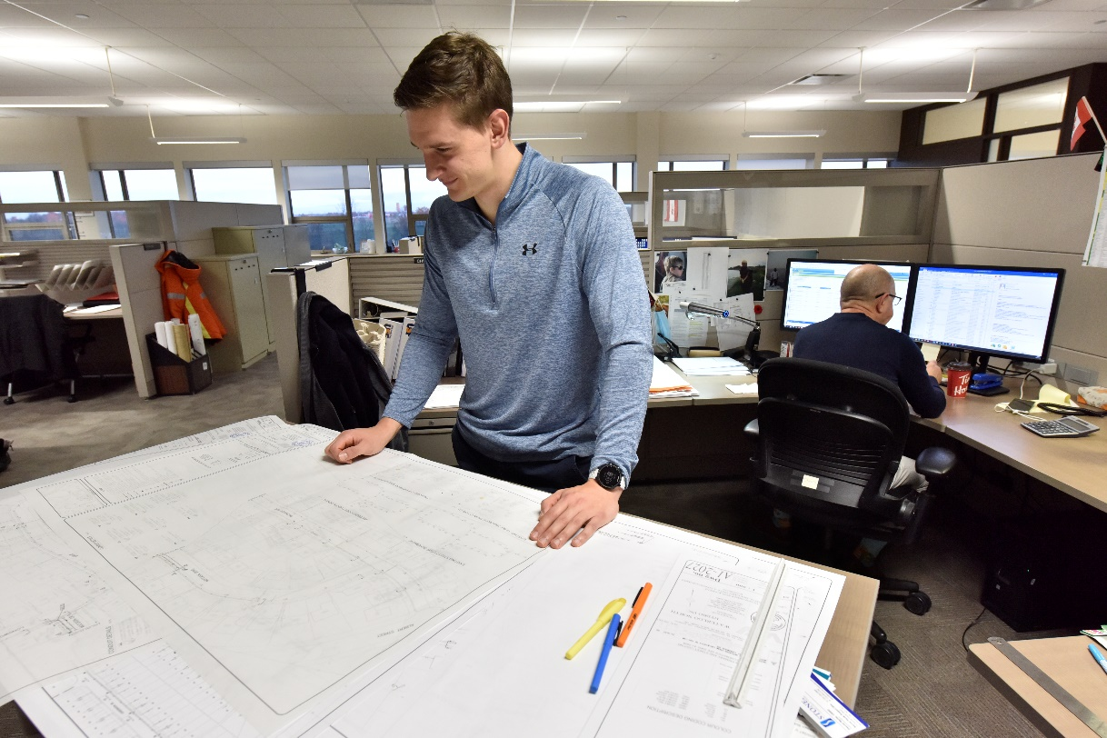
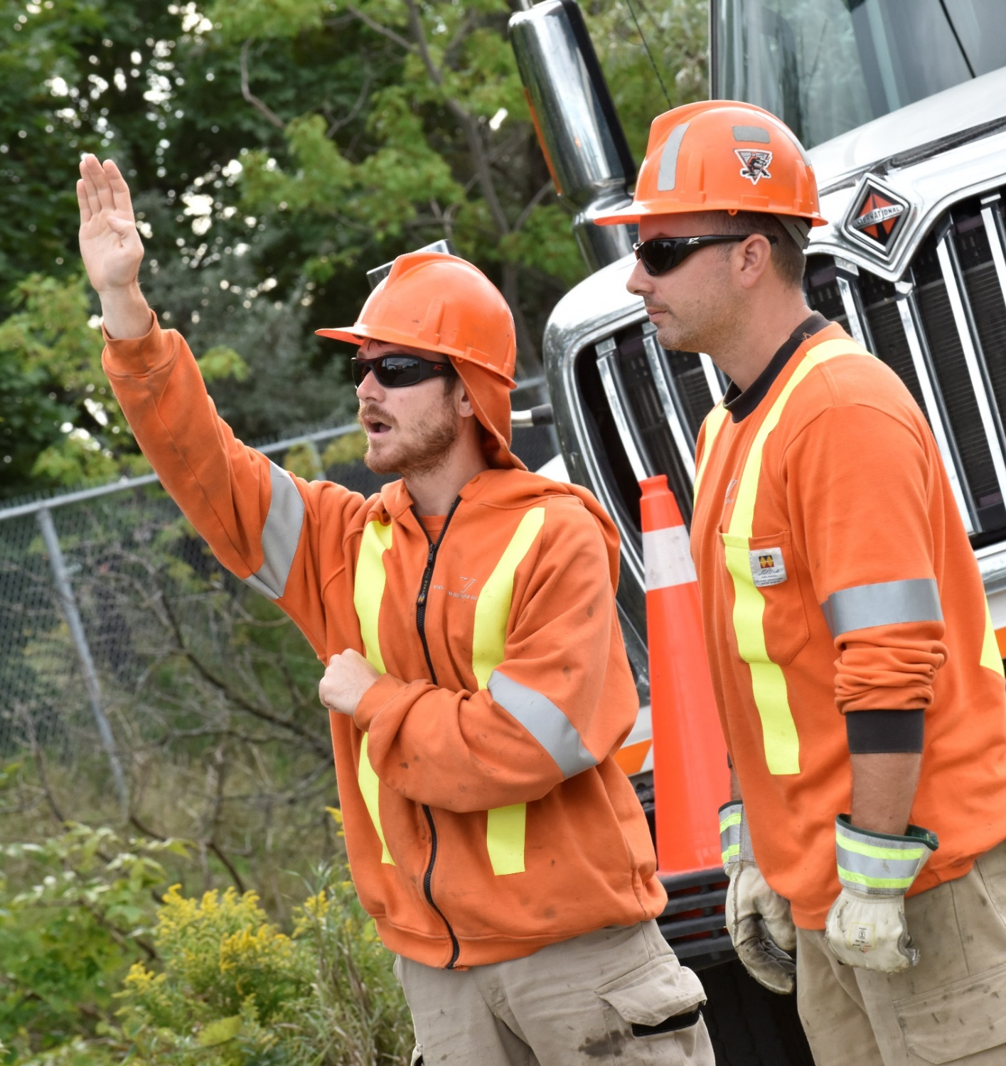
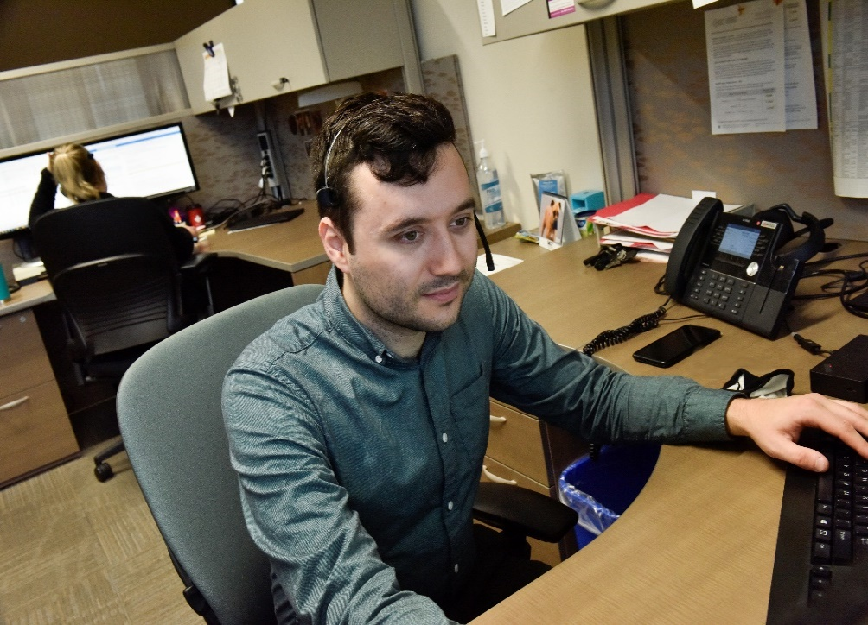
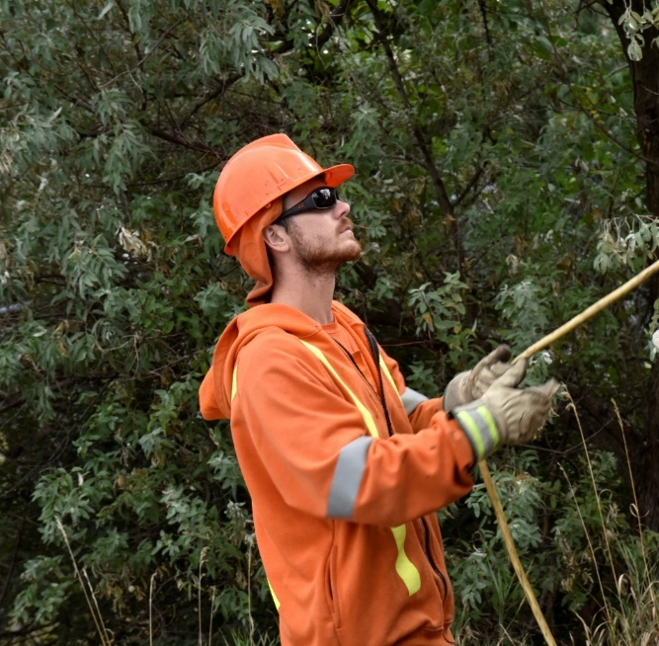
Enova Power. The smart friend you can rely on.

Slide 6
Evolution of Enova
(KWH & WNH)
Enova
Supplier
Energy Advisor
Strategic Business Partner
Pre 2000
Provider of electricity – keep the lights on
2000 to 2022
Provider of electricity
Assistance with energy conservation and energy efficiency
2022 and Beyond
Provider of electricity
Assistance with energy conservation and energy efficiency
Project Partner for EVs, Solar, Battery Storage
Energy Management
Project Management
Possible Financing Partner
Suite/Sub-Metering

Slide 7
Enova’s Key Account Team and Support
How Enova can support you and your organization

Slide 8
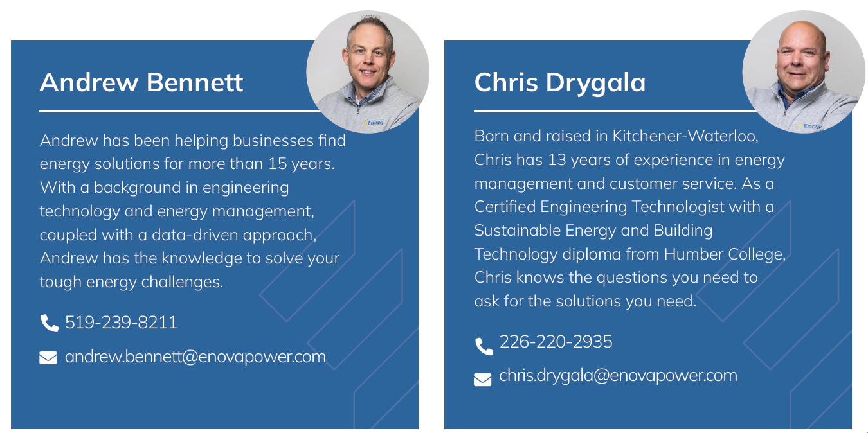
Know your ABCDs – the Enova Key Account Team
(AB)
(CD)
Notes:
Over 40 years combined experience energy management

Slide 9
Save on Energy Knowledge and Expertise
Years of program delivery and project support
Energy-saving opportunity identification, evaluation and analysis
Pre and post project measurement & verification (M&V)
New and existing incentive application support and representation
Notes:
1) Reviewed thousands of retrofit applications to know what opportunities exist
- we can help connect you to vendors/contractors, ensure equipment/proposal meet the program requirements and your needs
2) Assessed many types of facilities and evaluated all sorts of equipment to know which projects to do first, low-hanging fruit to complex system improvements
- example: Valley Blades cooling system, Eldorado dust collectors
- we can help develop the business case to sell to senior management by phrasing it in terms that can relate (widgets)
3) Large projects require measurements to be taken before and after a project is implemented and correlated to independent variables (compare apples to apples)
- we have two dozen data-loggers to measure power and consumption on multiple pieces of equipment simultaneously to capture an entire system (ie. air compressors and dryers)
4) Helped hundreds of customers submit retrofit incentive applications
we know what documentation is required to ensure a smooth technical review process
we prepare the submission on behalf of customers and contractors, take the load off
we won’t leave you hanging – contractors typically are less attentive once they’re paid

Slide 10
Pro Tips for a Successful Application Approval
Apply before you buy
Obtain a detailed quote – make/model and quantities
Measure where possible – remove subjectivity
Take before and after photos – QA/QC process
Keep your disposal receipts/records
Notes:
You must accept the participant agreement and submit your application before entering into a binding commitment or the application will be ineligible.
Required by the technical reviewer to verify eligibility and confirm incentive amounts
“Without data, you’re just another person with an opinion.” – Dr. William Edwards Deming
Assists technical review process, required for QA/QC (if applicable), important to get nameplate photos
Although they are not required as part of the post-project submission, you may be required to provide disposal records at a later date

Slide 11
Other Funding
Natural Resources Canada
Zero Emission Vehicle Infrastructure Program (ZEVIP)
Green Industrial Facilities and Manufacturing Program (GIFMP)
Clean Investment Tax Credits
Enbridge Programs & Incentives
Region of Waterloo Water Efficient Technology (W.E.T.) Program

Slide 12
Additional Support
Single point of contact
Project planning and energy management
GHG reduction, net zero consultation
Class A Global Adjustment mitigation strategies
Friendly reminders
Notes:
consider us your voice within the utility regarding billing questions, data requests, service upgrades, EV charging, generation connections, and more
we can assess your entire facility to help you prioritize projects with the best return on investment and assist you manage them from concept to completion
similar to efficiency projects, we can help you identify opportunities to reduce your GHG emissions and share our experiences with meeting net-zero targets
for Class A customers, we can help you understand the Global Adjustment charge and how to mitigate its impact to your utility bill
Class A Opt-In – June 15, EWRB – July 1

Slide 13
Questions?

